Slide 1
Mathematical Reconstruction of Patient-Specific Vascular Network Based on Clinical Images and Global Optimization
Supervisor: Nima Maftoon
Students: Yifan Jiang, Abdul Hannan Faruqi, Junhong Shen

Slide 2
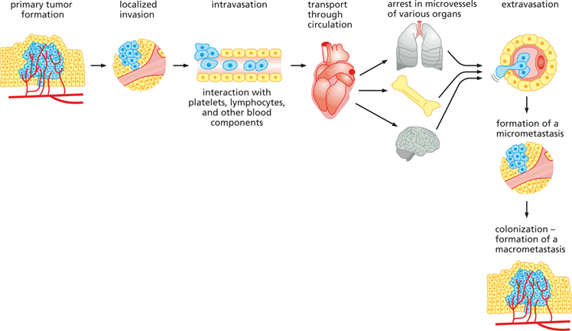
Motivation
Fig. 1 Metastasis
Modelling tumor growth and its vascularization
Blood flow plays a vital role in metastasis.
To study circulating tumor cells in metastasis and the location of secondary tumor sites detailed geometry of vascular network is needed.
Our computational framework is aimed at providing this detailed network structure which could aid in predicting metastasis sites.
Notes:
To metastasize, the cancer cells must detach from the primary tumor, intravasate into the bloodstream or lymphatic system, avoid immune protection, extravasate from the blood, finally migrate to distant organs, and proliferate to a secondary tumor.
More than two-thirds of metastatic sites could be explained by the blood flow links between the primary and secondary sites

Slide 3
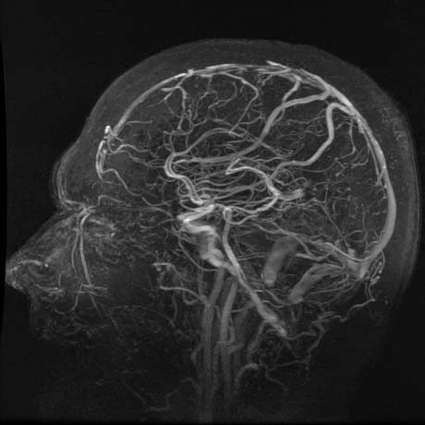
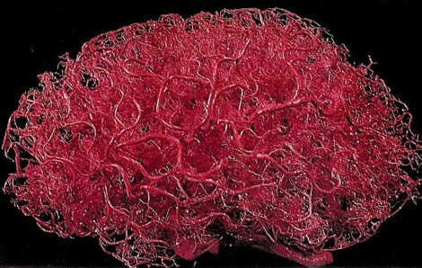
Patient-specific Vascular Network
Fig. 2 Brain Angiography
Fig. 3 Idealized Brain Vascular Network

Slide 4
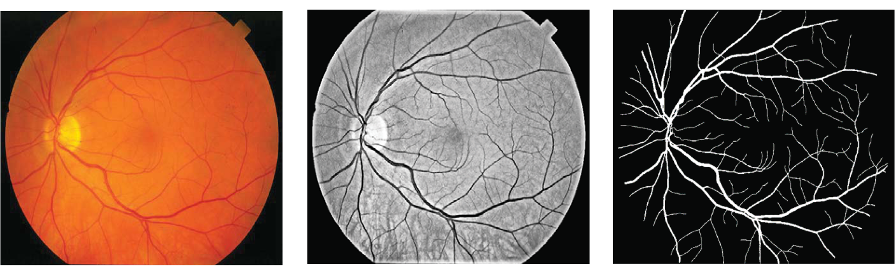
Traditional 3D Vessel Reconstruction
Medical Image Viewing
Image Segmentation
Centerline Extraction
Mesh Generation
Postprocessing
thresholding
region growing
edge detection
...
Fig. 4 Segmentation on Retina vessels

Slide 5
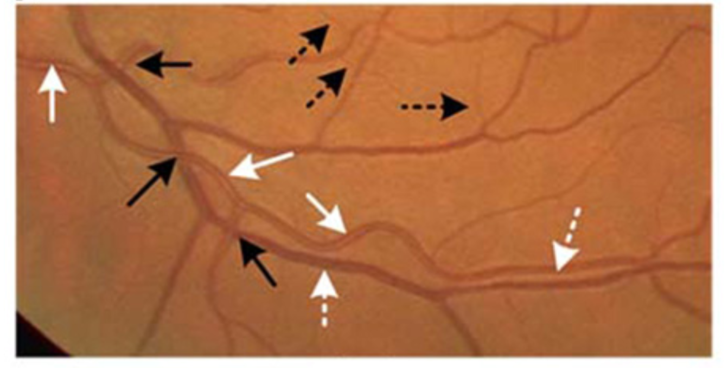
“Loss” of Segmentation
Computationally expensive
Failure to detect small vessels -> missing central parts of vessels
Partial merging of two vessels
Spurious segmentation at crossover
points
Fig. 5 Retina vessels

Slide 6
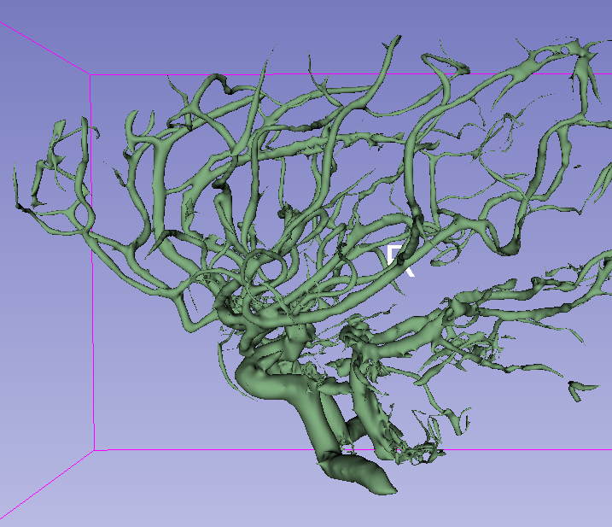
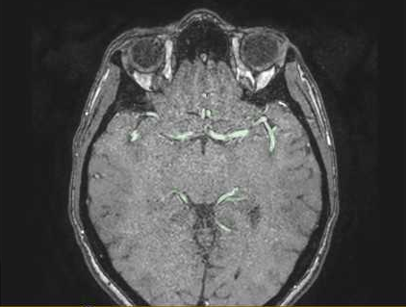

Main Problem: Discontinuity
(a) 2D slice obtained from 3D angiography of brain
(b) model constructed by 3D Slicer
Fig. 6 Previous Works

Slide 7
Hypothetical Modeling of Vascular Network
TABLE 1 | Comparison of Hypothetical Models
Methods | Key Features | Strengths | Weaknesses
Constructive Optimization | Introducing optimal branches | Widely used, updating | non-convex case
Compartment Model | lumped into compartment | Avoid the problem of non-convex case | factors taken into consideration are limited
Fractal Model | self similar models | Avoid optimization | not appropriate for general models
Angiogenesis-Based Construction | actual process | Combine with geometric parameters | involve additional assumptions
Notes:
opt: this model is widely used and studied, which is relatively mature and advanced feature and it is still updating. but for non-convex organ shape, it might requires more hypothesis and mathematical model to construct.
comp: This kind of models avoid the problem when consider the non-convex case (for example, heart), but factors taken into consideration are limited, mainly in the field of bio-fluid dynamics. moreover, it is relatively old method that is not usually used now.
fractal: Such approaches benefit from avoiding optimization problems so they are not so computationally heavy. The resulting vascular networks, however, suffer from an artificial overall structure, so that they are not appropriate for general models.
angio: One could combine angiogenesis models with geometric parameters by changing the way how new vascular edges form. This would, however, involve additional assumptions for the model and parameters in the algorithm, which are not easily observed experimentally.

Slide 8
Constructive Optimization Model
Constrained Constructive Optimization Models (CCO)
Global Constructive Optimization (GCO)
Main difference:
CCO finds an optimal tree by adding one branch one at a time
GCO finds optimal tree for all leaf nodes at the same time
Key concepts: position / perfusion volume / cost function
Notes:
We need to consider different PRNSs to generate the location of branches, then modified that. It can be correlated to variability of vascular trees in different individuals of same species
we also need to figure out different shape of perfusion volume because different shapes of perfusion areas induce different branching patterns, location of feeding vessels also influence the degree of optimality
The most important thing is the design of different target function,

Slide 9
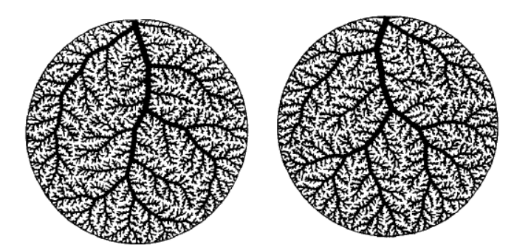
Motivation for GCO
Constrained constructive optimization (CCO) => [W. Schreiner, 1992].
Drawbacks:
Different networks are generated despite identical boundary conditions
Not suitable for patient specific networks
Advantages of GCO:
It is fully deterministic for a given set of boundary
conditions
It allows for topological changes during optimization
It integrates global multi-scale optimization strategies
Fig. 7 Effect of randomness
Notes:
After each addition, the newly created bifurcations are remodeled and all tree radii are adjusted.

Slide 10
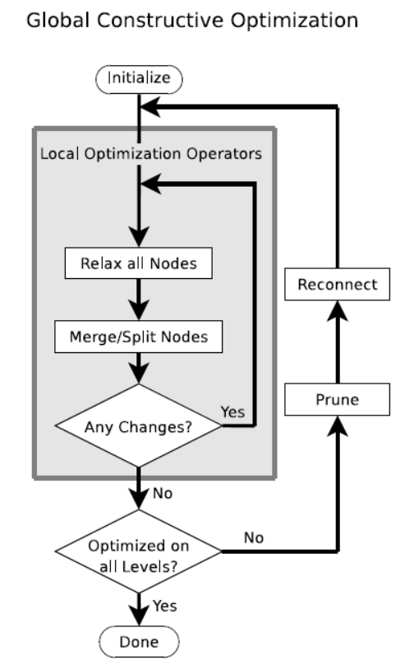
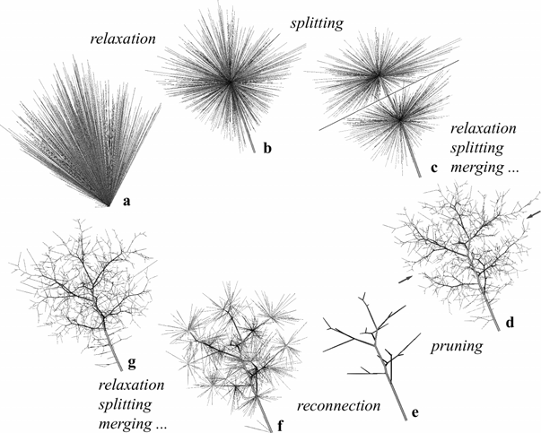
The Algorithm
(1) Relaxation
Fig. 8 Relaxation
Fig. 9 GCO Algorithm

Slide 11
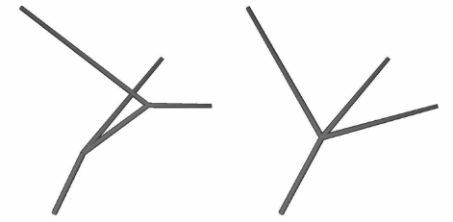
The Algorithm
(2) Merging
Fig. 10 Merging

Slide 12
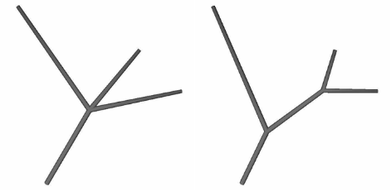
The Algorithm
(3) Splitting
Fig. 11 Splitting

Slide 13
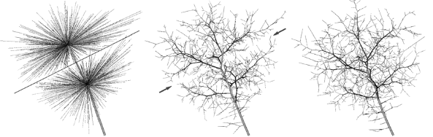
The Algorithm
(4) Pruning
Fig. 12 Effect of Pruning

Slide 14
Cost function for Relaxation
The cost function is the basis of the relaxation procedure.
It is defined as a measure to evaluate the efficiency of the vascular network.
It takes into account physiological factors like material and energy requirements.
The derivative of the cost function gives the direction of branching
The cost function in the present work contains contributions from two factors, namely
Material Cost
Power Cost

Slide 15
Our Framework
Image-based 3D Vessel Reconstruction with Structure Approximation
Medical Image Preprocessing
Large Vessel Extraction
Optimization-based Structure Refinement (Global Constrained Optimization)
Volume Generation
Postprocessing
Global optimization solved by GCO: merge / split / prune
Local optimization solved by relaxation

Slide 16
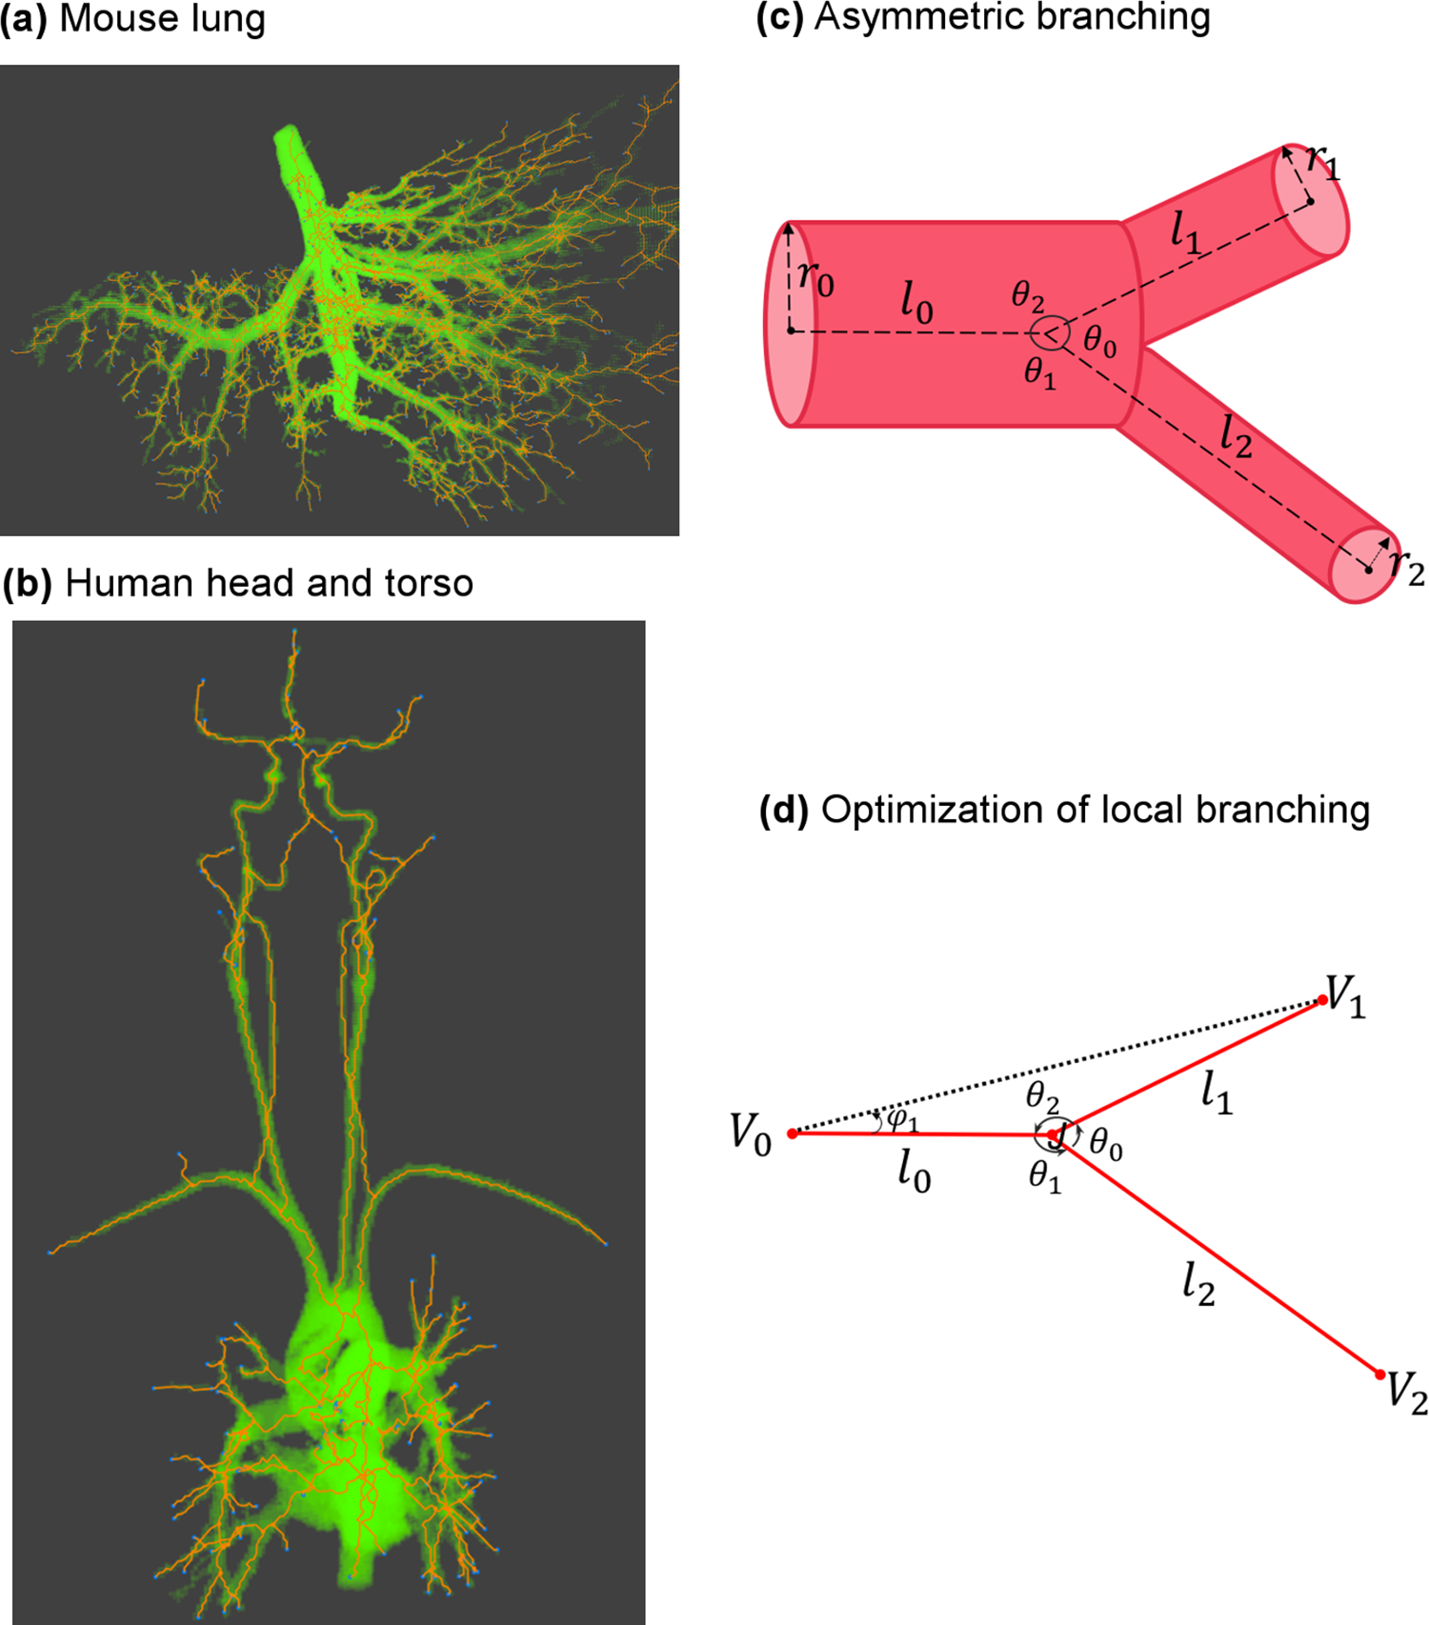
Cost Function: Material Cost
Tubular surface-area: the amount of material necessary for vessel construction primarily depends on the surface-area of the vessel.
Tubular volume: the material devoted to the blood is proportional to the blood volume.
Fig. 9 2D model of bifurcation
Notes:
There are two types of material that are needed for the vascular system, blood vessels (endothelial cells) and blood (plasma and white and red blood cells). The amount of material necessary for vessel construction primarily depends on the surface-area of the vessel 2πrl. In contrast, the material devoted to the blood is proportional to the blood volume (πr2l). MC optimizations can be built upon these two different characteristics (surface-area (MC-SA) or volume (MC-V)). We consider both cases here.

Slide 17
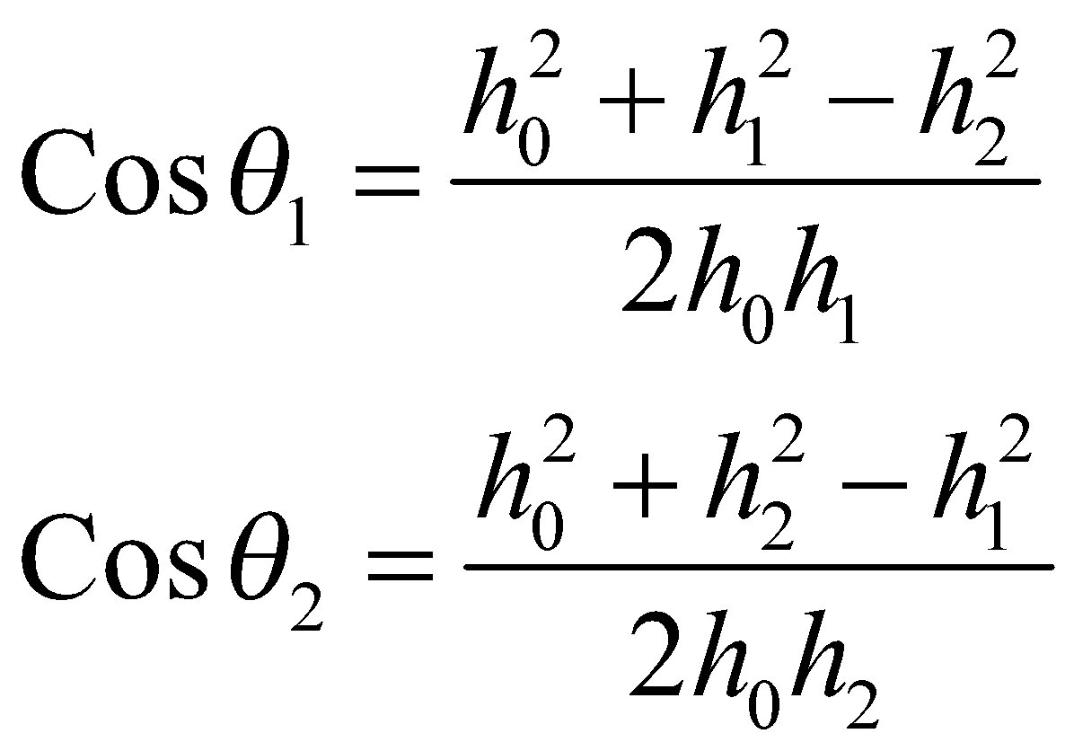
Material Cost: Solution
Fig. 13 2D Bifurcation Model
Notes:
There are two types of material that are needed for the vascular system, blood vessels (endothelial cells) and blood (plasma and white and red blood cells). The amount of material necessary for vessel construction primarily depends on the surface-area of the vessel 2πrl. In contrast, the material devoted to the blood is proportional to the blood volume (πr2l). MC optimizations can be built upon these two different characteristics (surface-area (MC-SA) or volume (MC-V)). We consider both cases here.

Slide 18
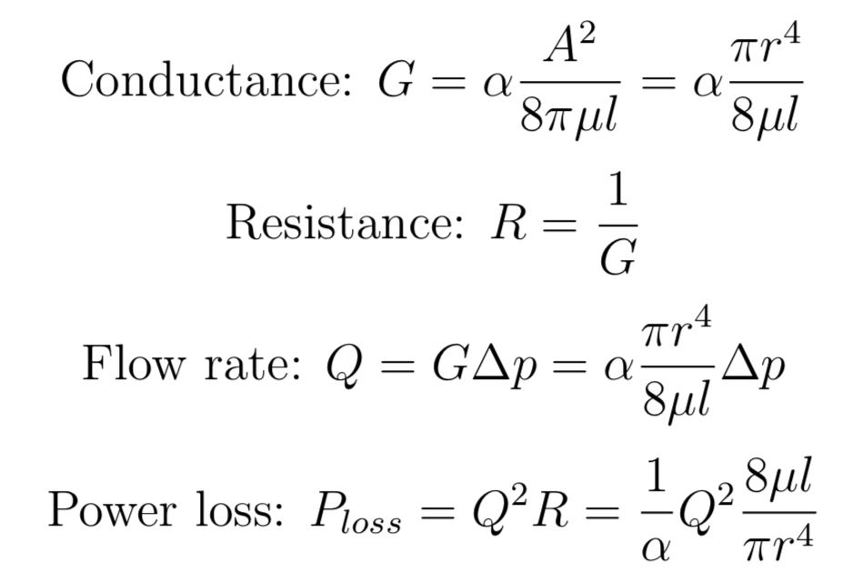
Power Cost: Blood Circulation
Notes:
In this way, as much of the additional power as possible is then redis- tributed and devoted to other needs such as foraging and reproduction [2, 5]. Much of the power that is required to push blood through the parent and daughter vessels is lost due to dis- sipation, especially in the smaller vessels that dominate the numbers and energetics of the whole vascular network. We calculate the power dissipated by a single vessel in terms of the volume flow rate of the blood (Q_ ) and the impedance (Z) via the formula
Foranycollectionofvessels,totalvolumeflowrateQ_TOT isdefinedbyflowthroughasingle cross section that cuts through all vessels at the same branching level. Equivalent impedance Zeq for the collection of vessels is defined by Z 1⁄4 Dp=Q_ , based on fluid dynamics (analogue to Ohm’s Law), where Δp is the pressure difference across the extreme endpoints through which blood flows in and out of the entire collections of vessels.

Slide 19
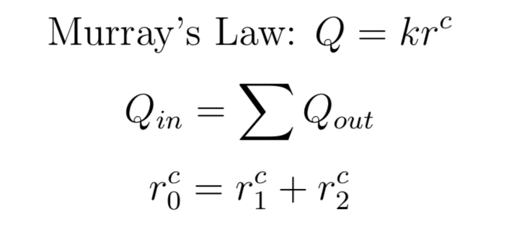
Power Cost: Constraints
Notes:
In this way, as much of the additional power as possible is then redis- tributed and devoted to other needs such as foraging and reproduction [2, 5]. Much of the power that is required to push blood through the parent and daughter vessels is lost due to dis- sipation, especially in the smaller vessels that dominate the numbers and energetics of the whole vascular network. We calculate the power dissipated by a single vessel in terms of the volume flow rate of the blood (Q_ ) and the impedance (Z) via the formula
Foranycollectionofvessels,totalvolumeflowrateQ_TOT isdefinedbyflowthroughasingle cross section that cuts through all vessels at the same branching level. Equivalent impedance Zeq for the collection of vessels is defined by Z 1⁄4 Dp=Q_ , based on fluid dynamics (analogue to Ohm’s Law), where Δp is the pressure difference across the extreme endpoints through which blood flows in and out of the entire collections of vessels.

Slide 20
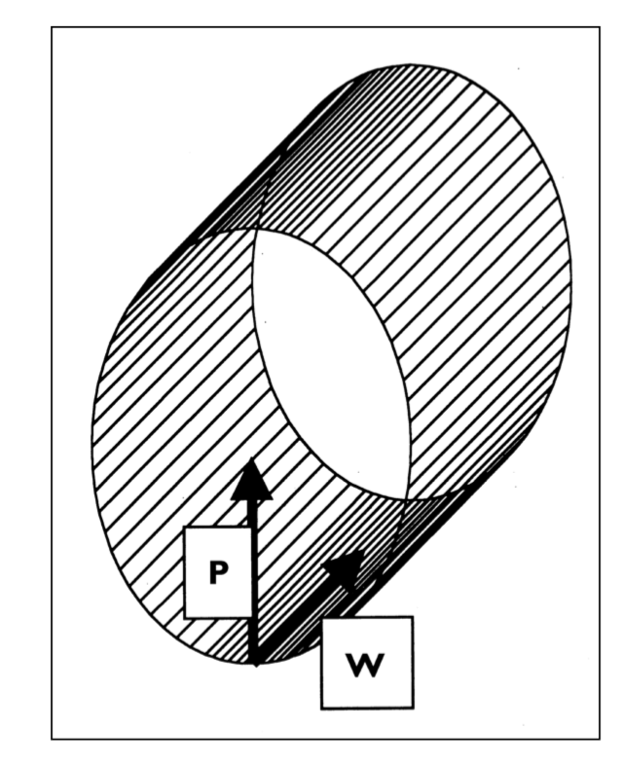
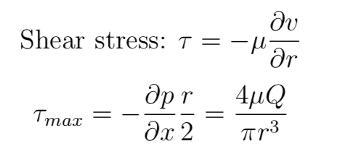
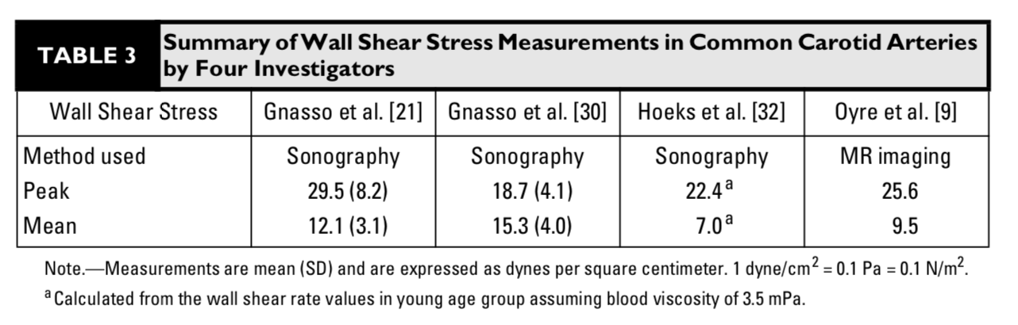
Biological Constraints: Shear Stress
Fig. 14 Shear Stress
Notes:
under conditions of Poiseuille flow the shear stress, τ, was given by
where η is viscosity and Q is flow rate; hence there would be constant shear stress throughout a bifurcating network conforming to Murray’s law. Given the known sensitivity of endothelial cells to shear stress and other work suggesting that shear stress influenced vascular calibre,28 Zamir therefore proposed that shear stress acting on endothelial cells might prove to be the major mechanism maintaining blood vessel diameter around the Murray optimum.

Slide 21
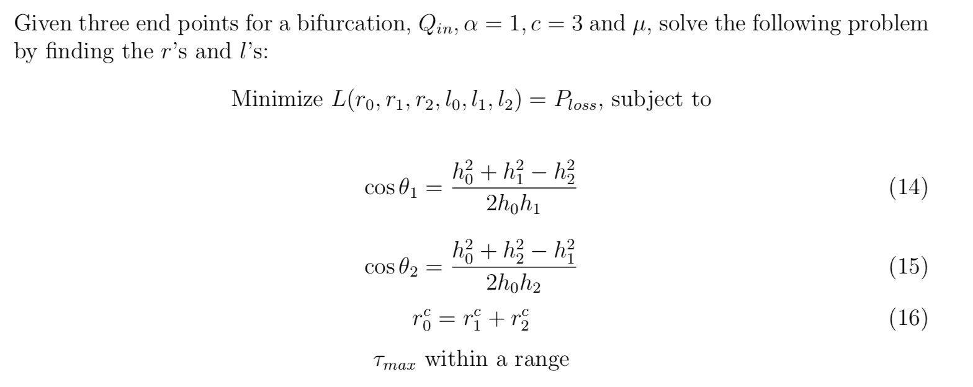
Local Optimization for Relaxation

Slide 22
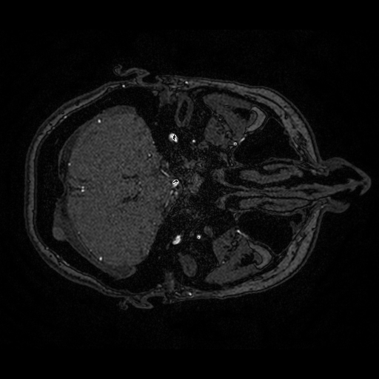
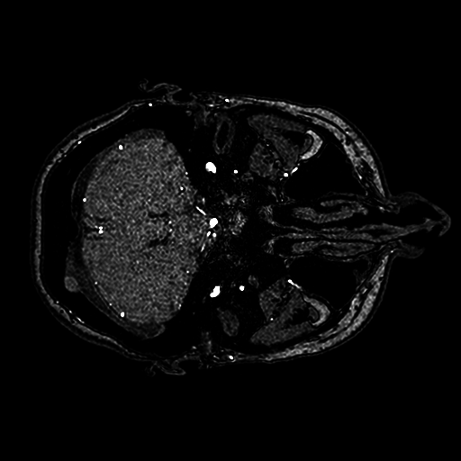
Implementation: Preprocessing
Clip intensity
Normalize
Cubic projection
Before
After
Fig. 15 Effect of Preprocessing
Notes:
In our experiments, we use different datasets that come from different sources and acquisition modalities. Therefore, we need to normalize their intensity ranges and contrast. We test the following preprocessing strategies to achieve homogeneity between the datasets.
First, the original intensities are normalized to the range [0, 1] using
f (x) = x−min(X) where x is the pixel intensity and X max(X)−min(X)
denotes the range of all intensities in the volume. The second strategy involves clipping the intensity values by g(x) = {c, x > c; x, x ≤ c} and then normalizing the intensi- ties by f (x). Our experiments show that a value of c = 190 is optimal for the intensity range of the datasets. The final strat- egy builds on the second preprocessing strategy by clipping by g(x), normalizing by f(x), and then projecting the resulting intensities by the function q(x) = xp. In our experiments, we test quadratic and cubic projections (i.e. p = 2 and p = 3, respectively).

Slide 23
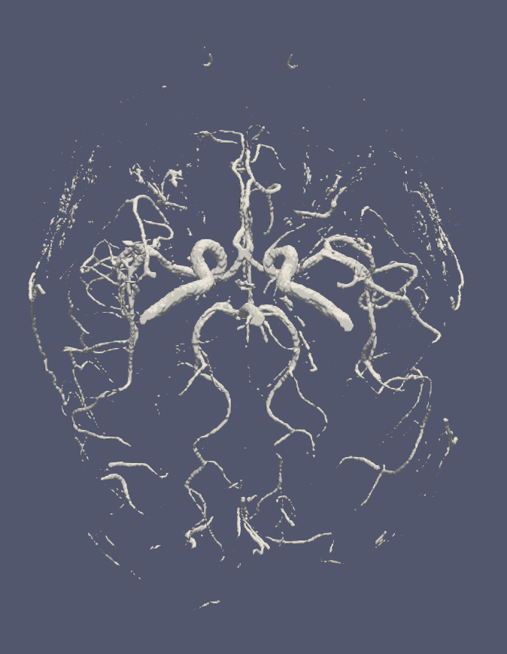
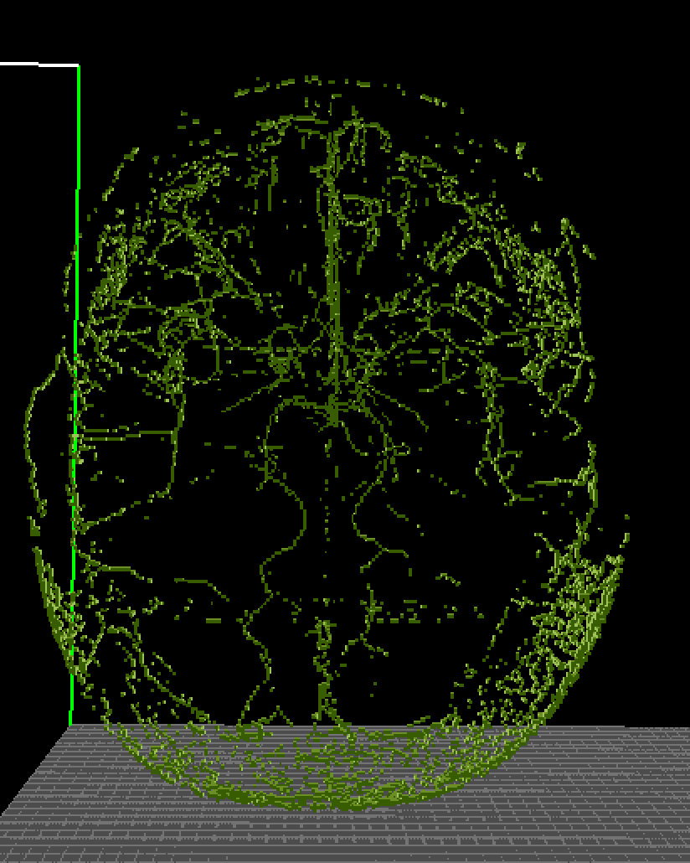
Implementation: Voxelize
Fig. 16 3D Models

Slide 24
Implementation: Optimization Algorithm
Gradient descent with randomly sampled initial points

Slide 26
Future Thoughts
Incorporate vesselness map into optimization
Angiogenesis-based optimization -> resource distribution problem

Slide 27
List of Tables and Figures
Tables
Table 1
Table 2
Figures
Fig. 1
Fig.2
Fig. 3, 4, 5, 6, 7

Slide 28
References
Christopher P.Cheng. Chapter 4 - Geometric Modeling of Vasculature. Academic Press, 2019, pp. 45–66. isbn: 9780128157138. doi: https:// doi.org/10.1016/B978-0-12-815713-8.00004-8.
Cemil Kirbas and Frances Quek. “A Review of Vessel Extraction Techniques and Algorithms”. In: ACM Computing Surveys 36.2 (2004), pp. 81– 121.
Elif Tekin et al. “Do Vascular Networks Branch Optimally or Randomly across Spatial Scales?” In: PLOS Computational Biology 12.11 (2016), e1005223. doi: 10.1371/journal.pcbi.1005223.
Ferdinand le Noble Elizabeth A. V. Jones and Anne Eichmann. “What Determines Blood Vessel Structure? Genetic Prespecification vs. Hemodynamics”. In: Physiology 21 (2006), pp. 388–395. doi: 10.1152/physiol. 00020.2006.
Santhosh Kumar K. Sudhir B. J. “Moyamoya Disease: Using Computational Fluid Dynamics to propose a novel “Mechanical Theory” of pathogenesis”. In: ICIIBMS 2018, Track 3: Bioinformatics, Medical Imaging and Neuroscience, Bangkok, Thailand. IEEE. 2018.
Secomb TW Pries AR and Gaehtgens P. “Design principles of vascular beds”. In: 2008 IEEE Conference on Soft Computing in Industrial Applications 77 (1995), pp. 1017–1023.
F.Caliv ́aetal.“A Fluid-Dynamic Based Approach to Reconnect the Retinal Vessels in Fundus Photography”. In: 2017 39th Annual International Conference of the IEEE Engineering in Medicine and Biology Society (EMBC), Seogwipo. 2017, pp. 360–364. doi: 10.1109/EMBC.2017. 8036837.

Slide 29
Nelson T R , Manchester D K . Modeling of lung morphogenesis using fractal geometries.[J].
Schwen L O , Preusser T . Analysis and Algorithmic Generation of Hepatic Vascular Systems[J]. International Journal of Hepatology, 2012, 2012:1-17.
Elif T , David H , Newberry M G , et al. Do Vascular Networks Branch Optimally or Randomly across Spatial Scales?[J]. PLOS Computational Biology, 2016, 12(11):e1005223-.
Hughes, Alun D . Optimality, cost minimization and the design of arterial networks[J]. Artery Research, 2015, 10:1-10.
M. ZAMIR. Nonsymmetrical Bifurcations in Arterial Branching[J]. Journal of General Physiology, 1978, 72(6):837.
Zamir, M. The role of shear forces in arterial branching[J]. The Journal of General Physiology, 1976, 67(2):213-222.
Murray, C. D . THE PHYSIOLOGICAL PRINCIPLE OF MINIMUM WORK APPLIED TO THE ANGLE OF BRANCHING OF ARTERIES[J]. The Journal of General Physiology, 1926, 9(6):835-841.
Georg M , Preusser T , Hahn H K , et al. Global Constructive Optimization of Vascular Systems[J]. 2010.

